Slide 1
Local Interpretable Model-Agnostic Explanations
(LIME)
Aidan Donnellan, Garrett Kemper
ELE392

Slide 2

What Is Lime
LIME stands for Local Interpretable Model-Agnostic Explanations.
Improves interpretability of your model.
Explains the individual predictions that your model makes.
This method allows it to be supported by all types of models.

Slide 3
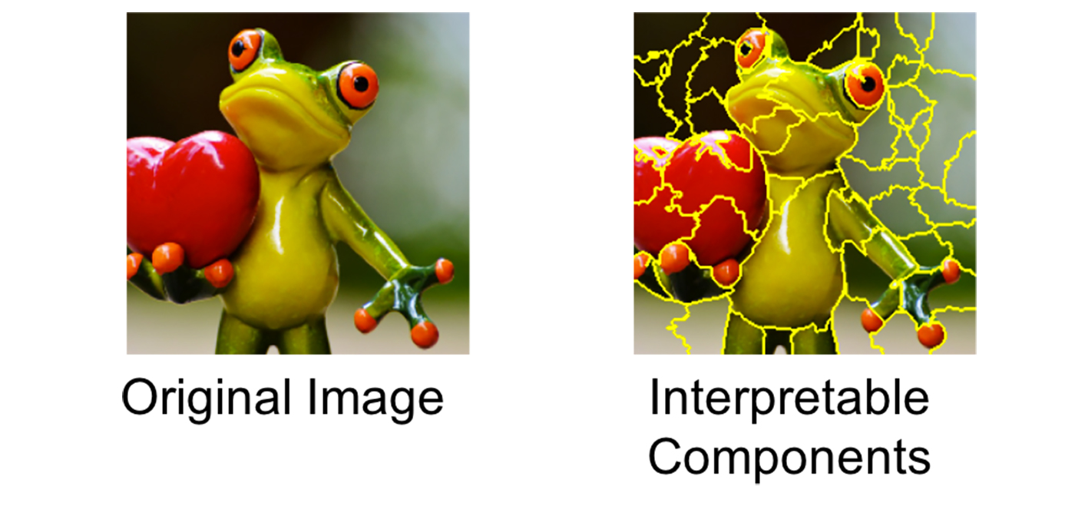
What Does It Do
Explains any black-box model
Supports tabular, text and image based datasets
Visualisations created make the models more transparent to the maker and are easier to explain.
Gives insights into which features are the most significant for predictions

Slide 4
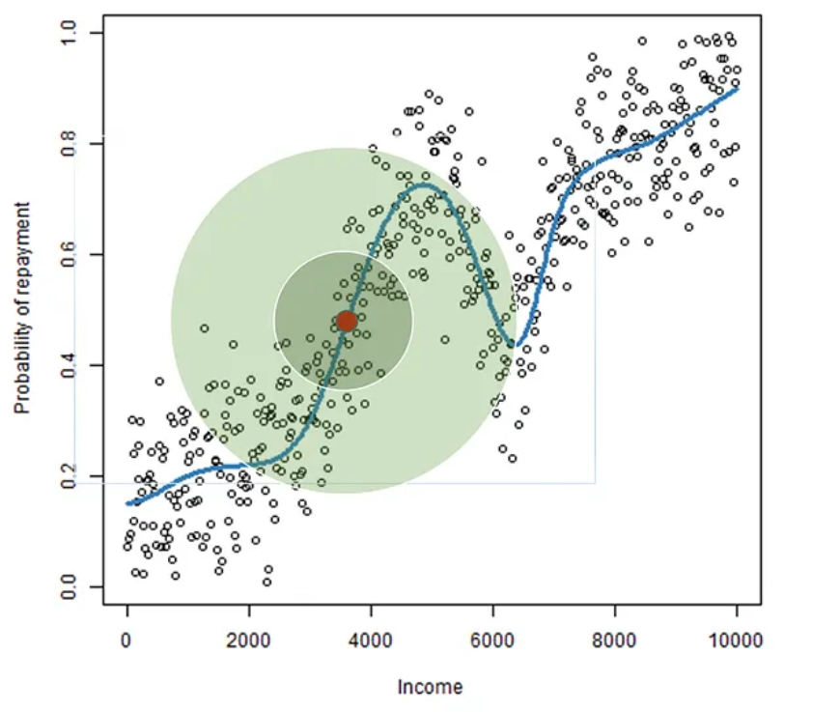
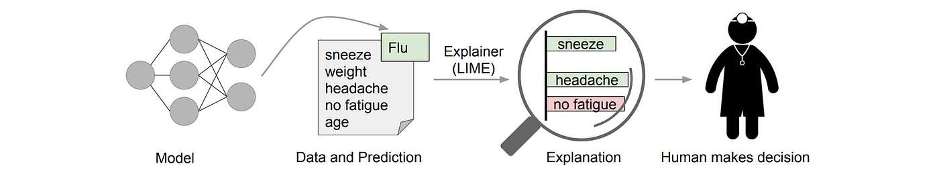
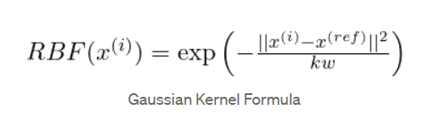
How Does It Work

Slide 5
How Does It Work
Local
Approximates model in a local window
Focus on a single prediction
Interpretable
Approximates complex model with simpler, readable model
Model-Agnostic
Can be applied to any machine learning model
Explanations
Explains your model’s explanations

Slide 6
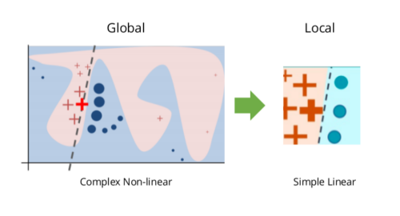
How Does It Work
Perturbation
Create small variations in the input
Model Sampling
Model makes predictions on the new inputs
Sample Weighting
Assigns higher weights to samples closer to original
Model Training
Trains a more interpretable model (ex. Linear regression or decision tree)
Generating Explanations
Determines which features contributed the most to a given prediction

Slide 7
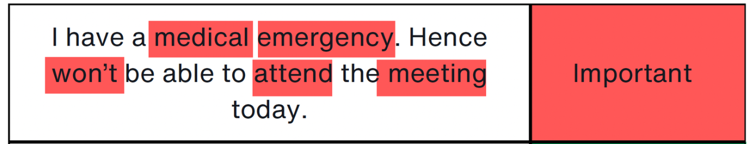
Applications
Can be used on any classification or regression model
Model Debugging: spotting spurious correlations of biases
Image Recognition: highlight most important pixels
Text Explanation: highlight most important words
Regulatory Compliance: Making black-box models explainable to end users

Slide 8
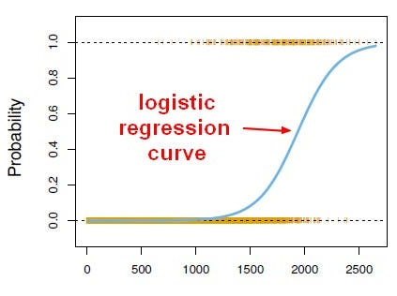
End User Application
Credit Card Company
Classifying risk of defaulting
Use LIME to inform the user why they were classified as high risk
Inform user how they can improve their risk classification

Slide 9
Limitations
Approximations
Models only make local approximations
May not be perfect for highly complex models
Computational Costs
Generates multiple models
May be slow for large datasets

Slide 10
Other Explanation Techniques
SHAP (SHapley Additive Explanations) - Computationally Expensive
Integrated Gradients
Grad-CAM - Better for CNNs in vision tasks

Slide 11
Colab Workshop
Workshop_LIME > ELE392_LIME_Workshop.ipynb

Slide 12
Resources
https://medium.com/data-science/lime-explain-machine-learning-predictions-af8f18189bfe
https://medium.com/intel-student-ambassadors/local-interpretable-model-agnostic-explanations-lime-the-eli5-way-b4fd61363a5e
https://lime-ml.readthedocs.io/en/latest/lime.html

